Slide 1


The Process of User Experience Design,

Slide 2
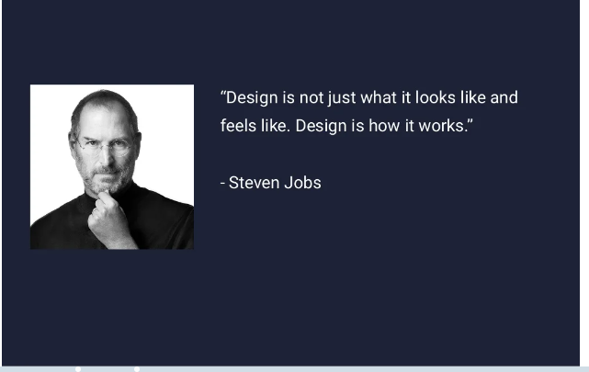

Slide 3
User Experience Design
User Experience Design is the process of enhancing user satisfaction by improving the usability, accessibility, and pleasure provided in the interaction between the user and the product.

Slide 4
The Process of User Experience Design,
If we apply design thinking to product design, we will follow a UX process with the following five key phases:
Product definition
Research
Analysis
Design
Validation

Slide 5
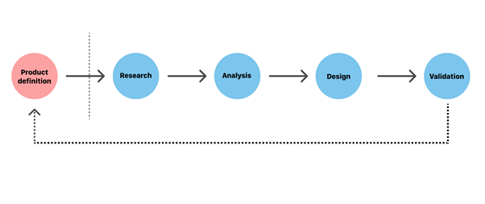

Slide 6
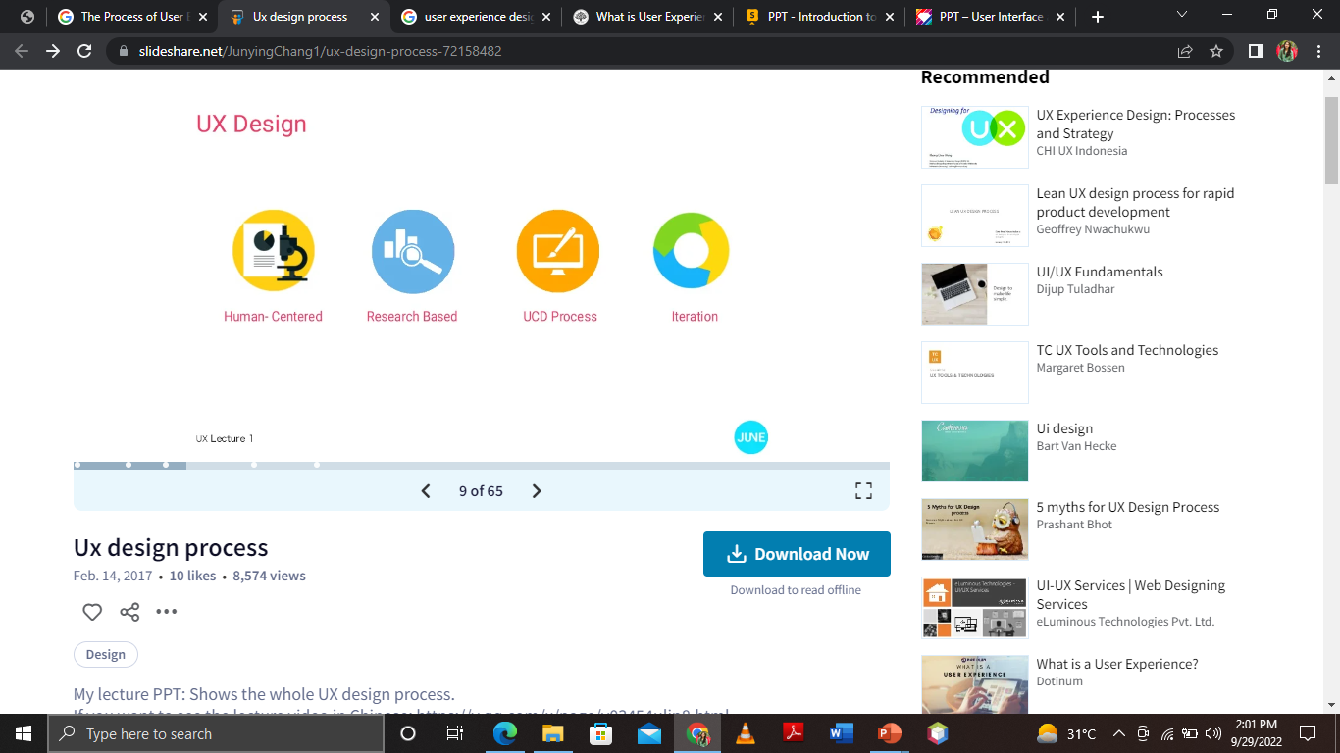
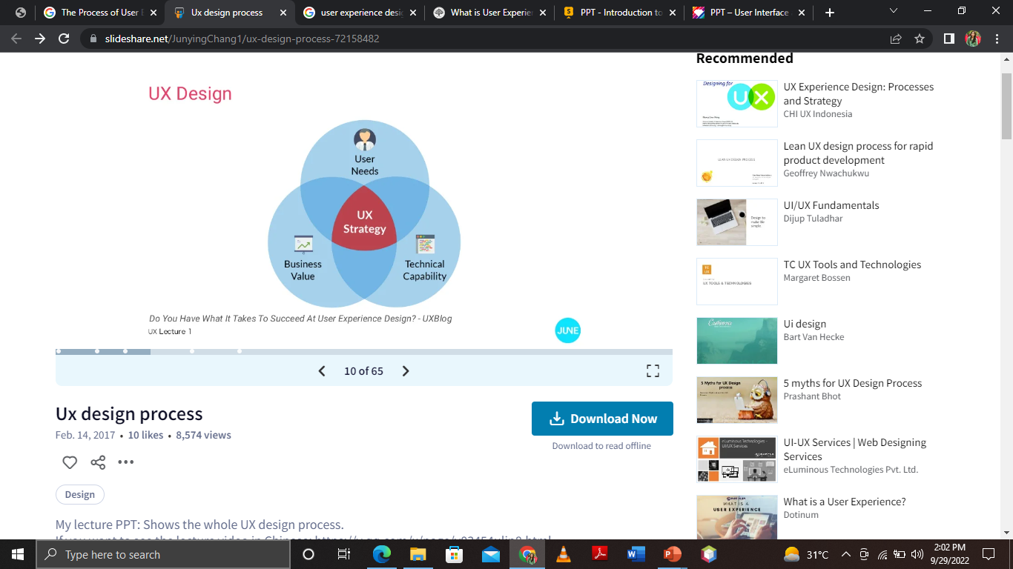

Slide 7
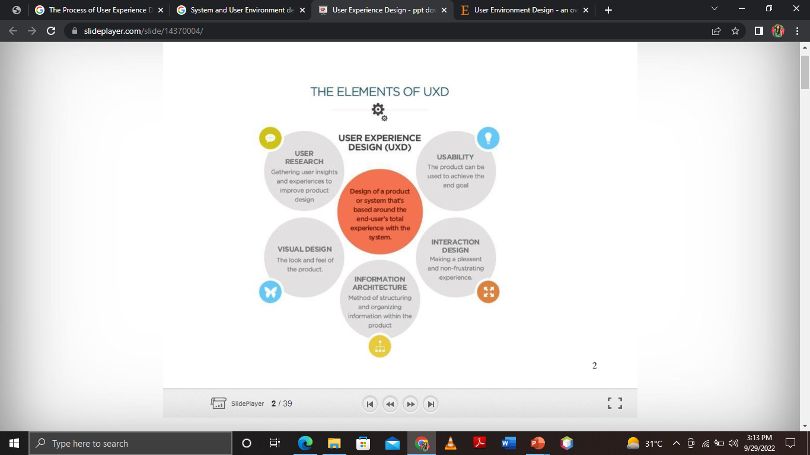

Slide 8
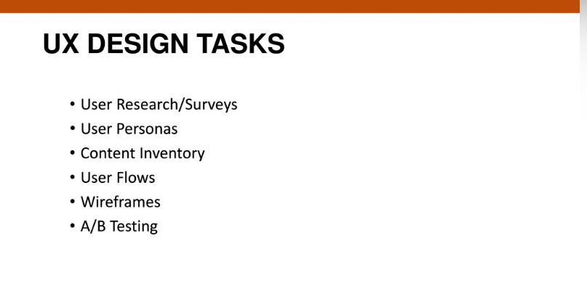

Slide 9
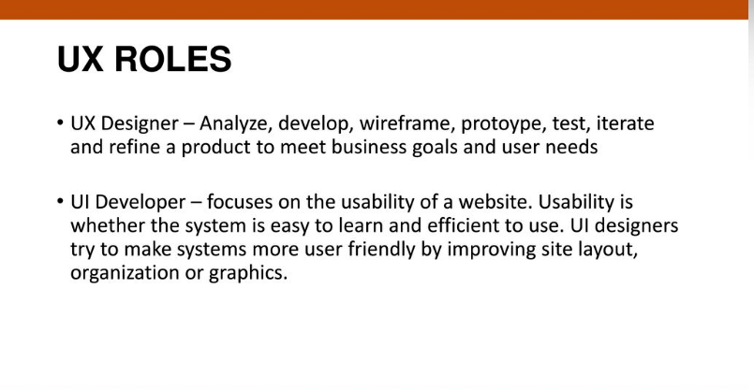

Slide 10
Product Definition

Slide 11
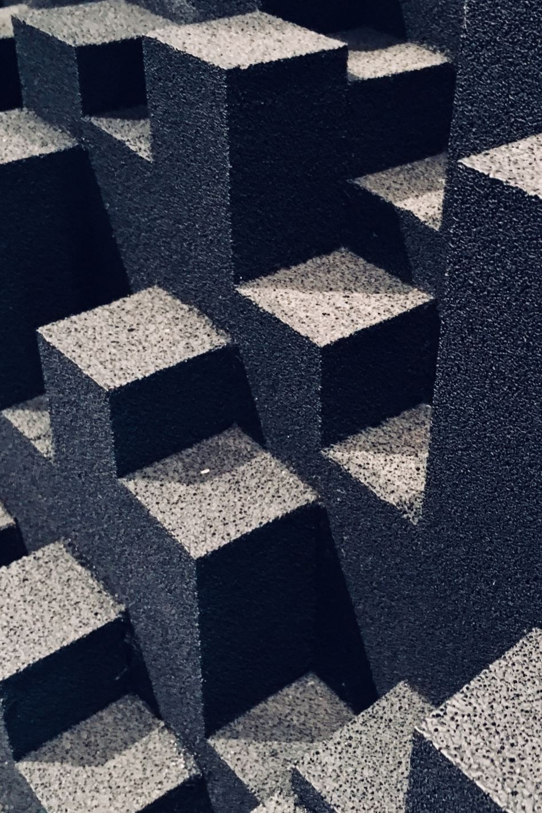
There are many ways of characterizing the activities involved in the UX design process.
‘Design has three activities:
understand,
observe and
visualize.’
‘
Notes:
Design has three activities: understand, observe and visualize.’
Design process
designers try to understand this mess.
designers .They observe how their products will be used; design is about users and use.
They visualize which is the act of deciding what it is.’

Slide 12
We characterize the overall design process in terms of the four activities
understanding,
envisionment,
design
evaluation

Slide 13
Understanding

Slide 14
understand
Understanding is concerned with what the system must do, what it must be like and how it must fit in with other things; with the requirements of the product, system or service.
Notes:
When u understand what system has to do
What will be requirement

Slide 15
Understanding :
Requirements
Stakeholders
environment

Slide 16
Analysing the environment and sinking the product with it, is very important in experience architecture.
Example :
Real time Application : Fast/ emergency environment (UBER APP)
Service based Environment : (Entertainment App)

Slide 17
Envisionment
Envisionment is standard to effective human-centred design, to enable designers to compare from other people’s perspectives and to explore design concepts and ideas with others. Different representations of design ideas are useful at different stages for different people.

Slide 18
Designs need to be visualized both
to help designers clarify their own ideas
to enable people to evaluate them
Basic Techniques of Envisionment are:
Sketches and snapshots
Story Boards
Prototypes
Mood boards
Navigation maps etc..

Slide 19
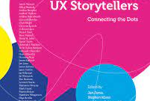
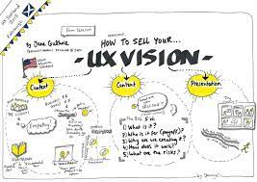
Envisionment is concerned with finding appropriate media in which to render design ideas.
The medium needs to be appropriate for the stage of the process, the audience, the resources available and the questions that the designer is trying to answer.

Slide 20
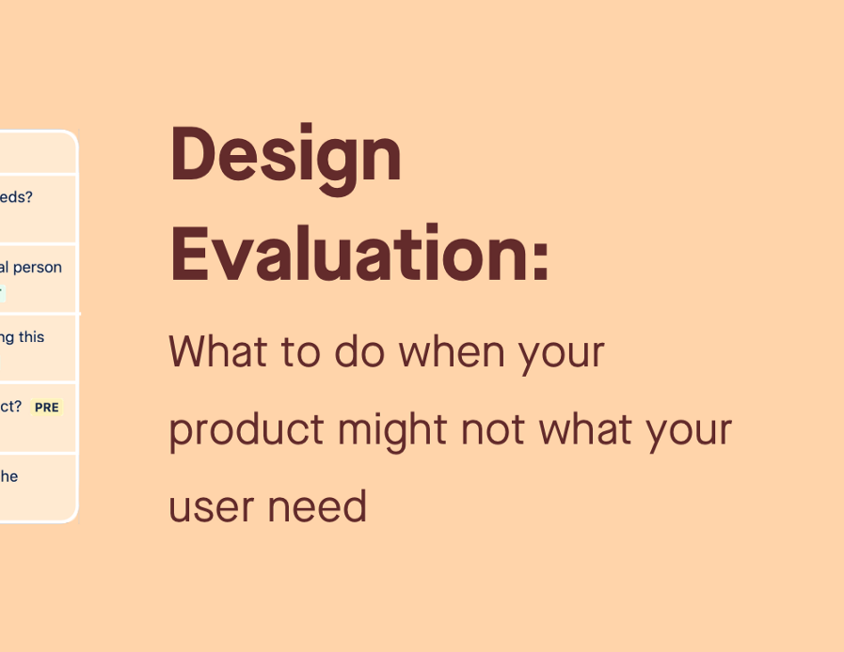
Evaluation:
Evaluation is tightly coupled with envisionment because the nature of the representation used will affect what can be evaluated.
The evaluation criteria will also depend on who is able to use the representation.
Any of the other design activities will be followed by an evaluation.

Slide 21
User experience Design Evaluation or user experience assessment (UXA) refers to a collection of methods, skills and tools utilized to uncover how a person perceives a system (product, service, non-commercial item, or a combination of them) before, during and after interacting with it.

Slide 22
Design
Conceptual
Physical design
Operational design
Notes:
Conceptual design is about designing a system in the abstract(Use Cases , Erd , Flow Diagrams etcs.)
Physical design is concerned with how things are going to work and with detailing the look and feel of the product. (clarifying and presenting the allocation of functions )
Operational Design (Taking a functional view of an activity means focusing on processes and on the movement, or flow, of things through a system.
:Events )

Slide 23
Representational Design
Representational design is concerned with fixing on colours, shapes, sizes and information layout.
It is concerned with style and aesthetics and is particularly important for issues such as the attitudes and feelings of people, but also for the efficient retrieval of information.

Slide 24
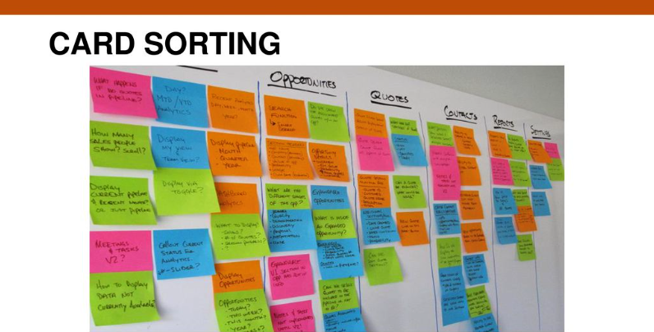

Slide 25
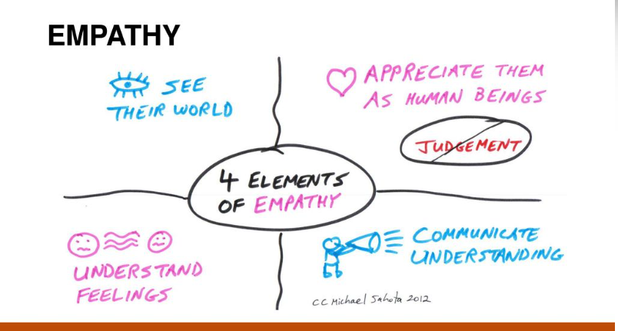

Slide 26
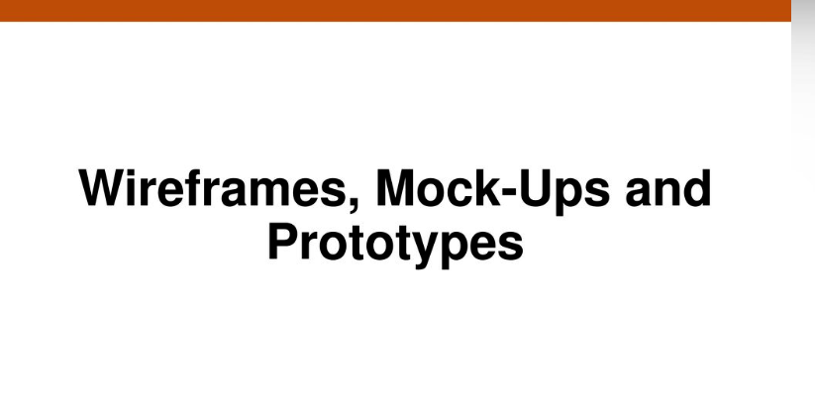

Slide 27
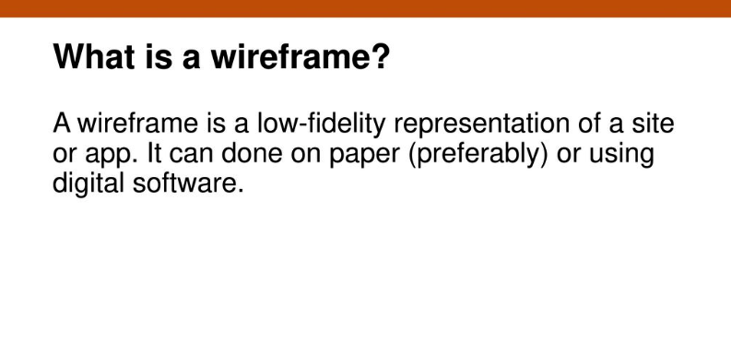

Slide 28
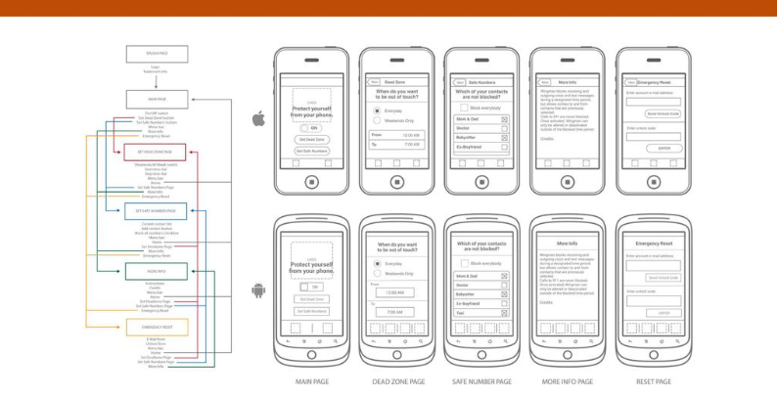

Slide 29
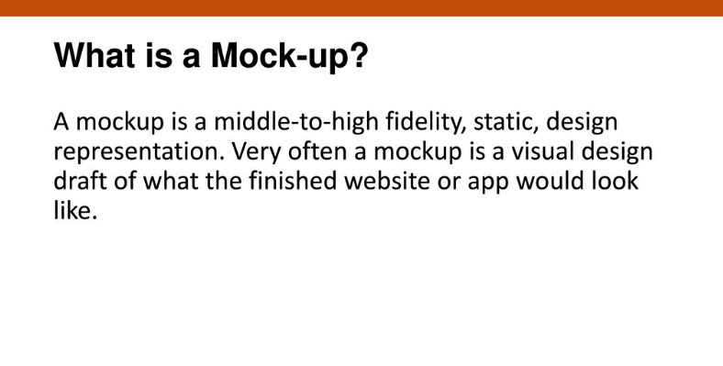

Slide 30
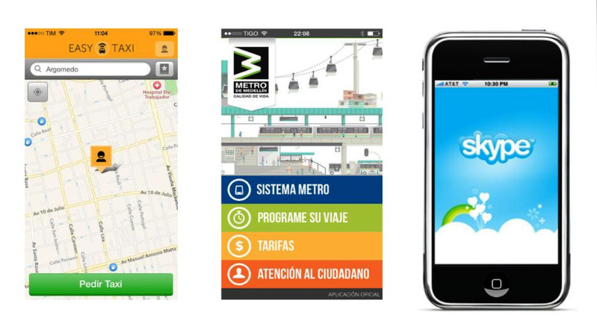

Slide 31
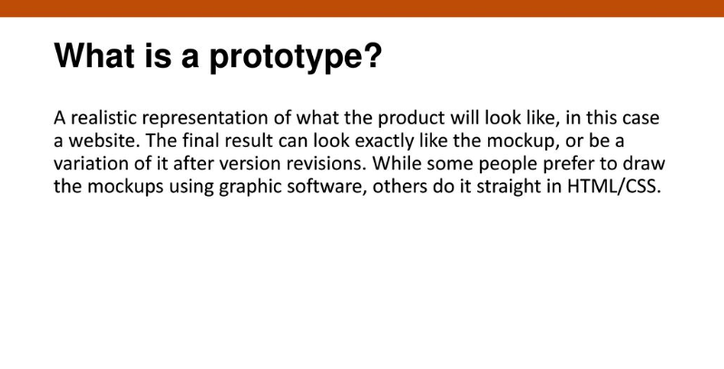

Slide 32
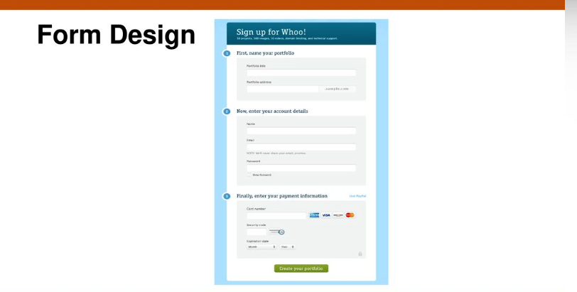

Slide 33
